Slide 1


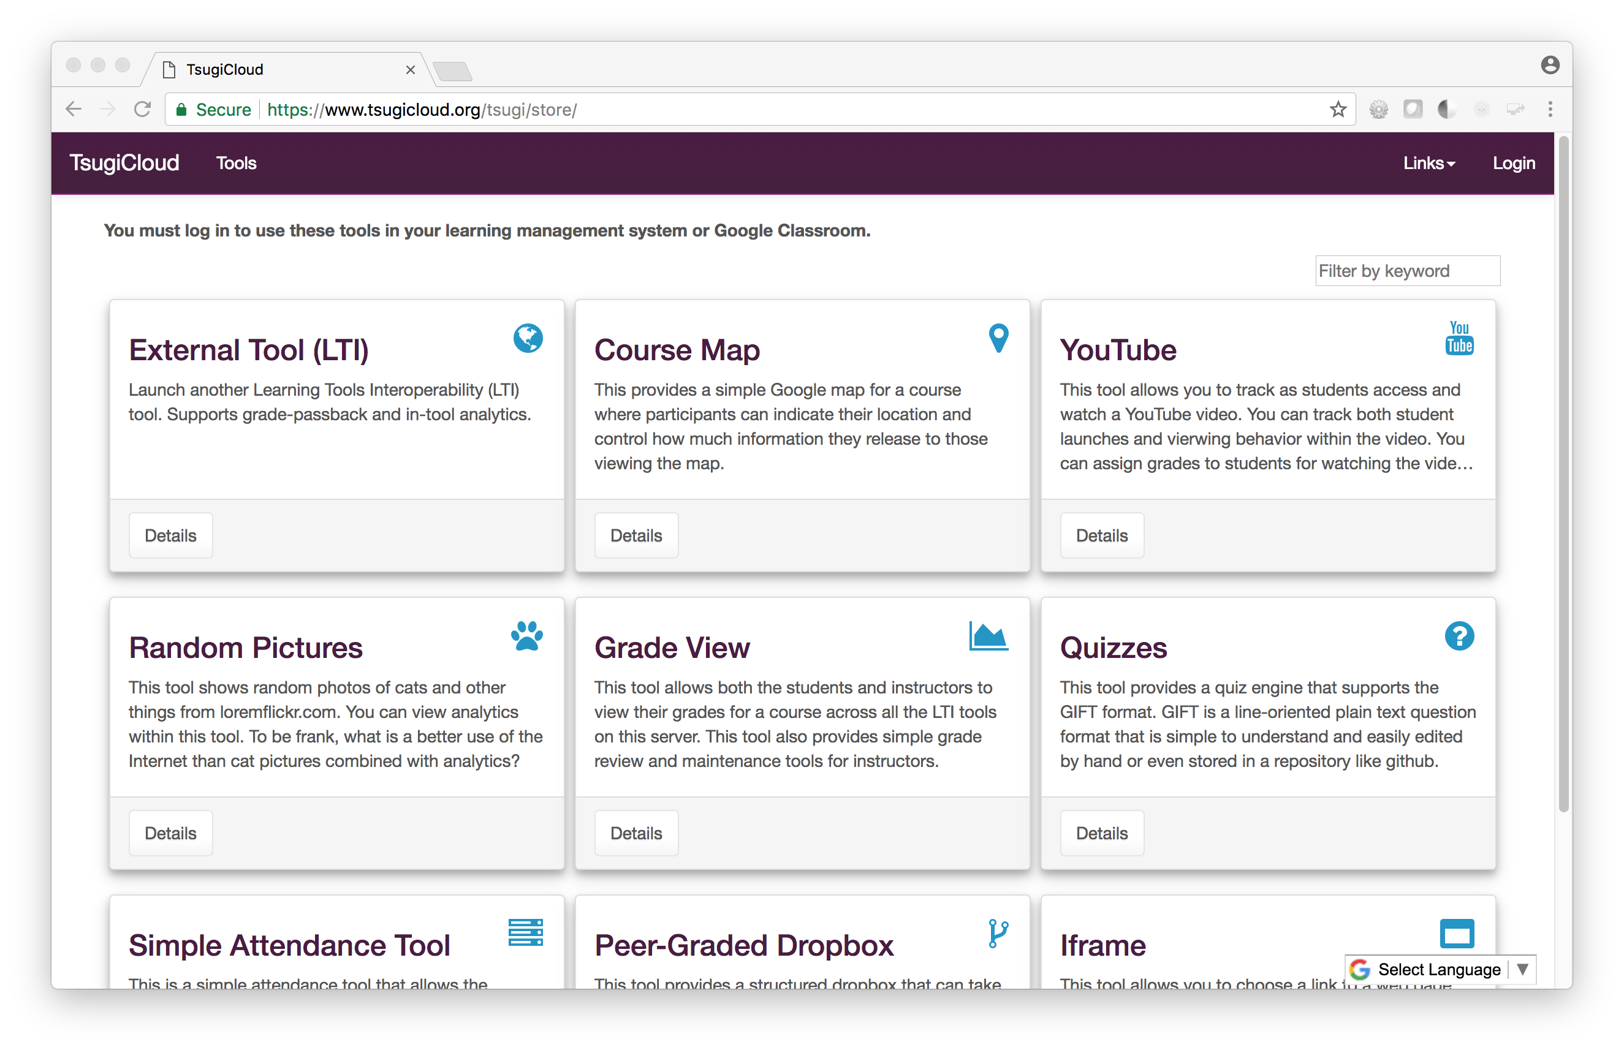









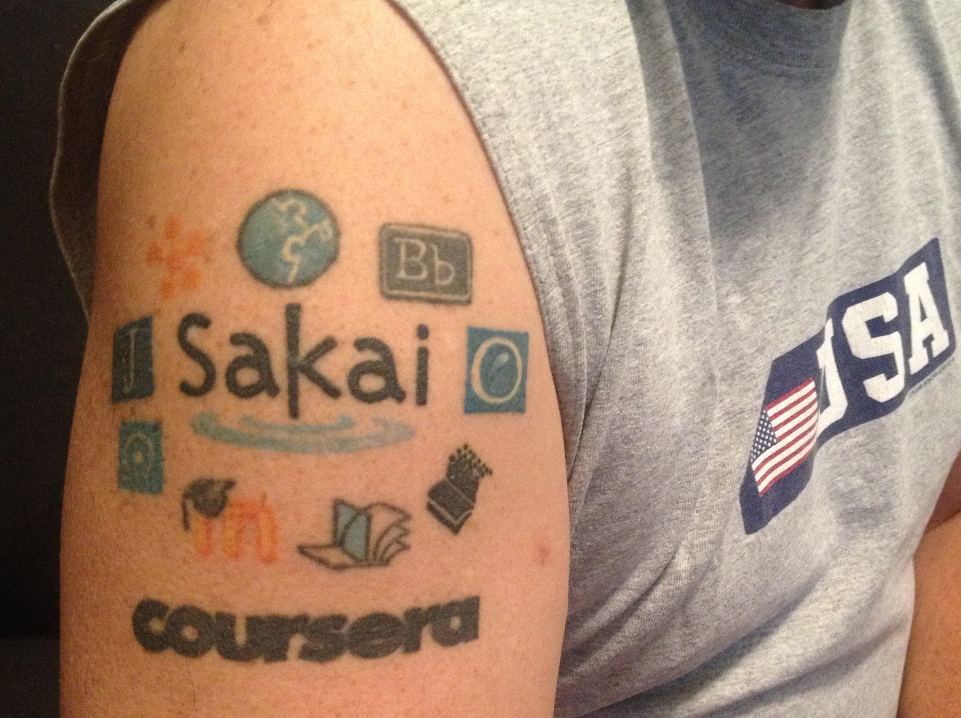
Tsugi: Building Applications for Education
Charles Severance
Instructional Designers
Faculty
Write a Learning Tool once and use it in your on campus courses and in your MOOCs…
Can build sharable assessments to support a textbook
Can build auto-graders for on-campus classes and reuse them in MOOCs
Can build *whatever* tool you can imagine
Quickly design and build unique tools for any course
Tools can extend functionality for any LMS
Checklist
Reflection
Tracked YouTube Viewer
IMS LTI® IMS Deep Linking® IMS Common Cartridge®
Developers
IT Staff
Write once integrate everywhere
Standards compliance made easy
Common UI / UX Patterns across tools
Share / sell your tools in App Stores like TsugiCloud
Can build sharable assessments to support a textbook
Can build auto-graders for on-campus classes and reuse them in MOOCs
Can build *whatever* tool you can imagine
Photo Credit: https://pixabay.com/en/users/Free-Photos-242387/

Slide 2

Science Project Title
Your name | Teacher’s name | School
Problem / Question
Materials
Results
Type your question here (statement of the problem)
Materials (detailed list) | Quantity (be specific)
Item | Amount
Item | Amount
Item | Amount
Item | Amount
Item | Amount
Item | Amount
Item | Amount
Hypothesis
Type your answer / solution here
Write hypothesis before you begin the experiment
This should be your best educated guess based on your research
Project Overview
Include results based on your experiments
Result 2
Result 3
Type a brief overview or summary of your project. (Click the Bullets button on the Home tab to remove the bullets.)
Conclusion
Brief summary of what you discovered based on results
Indicate and explain whether or not the data supports your hypothesis
Variables / Research
Controlled variables
These are kept the same throughout your experiments
Independent variable
The one variable you purposely change and test
Dependent variable
The measure of change observed because of independent variable
Decide how you will measure the change
Observation 1
Observation 2
Observation 3
Works Cited
Include print and electronic sources in alphabetical order

